Slide 1
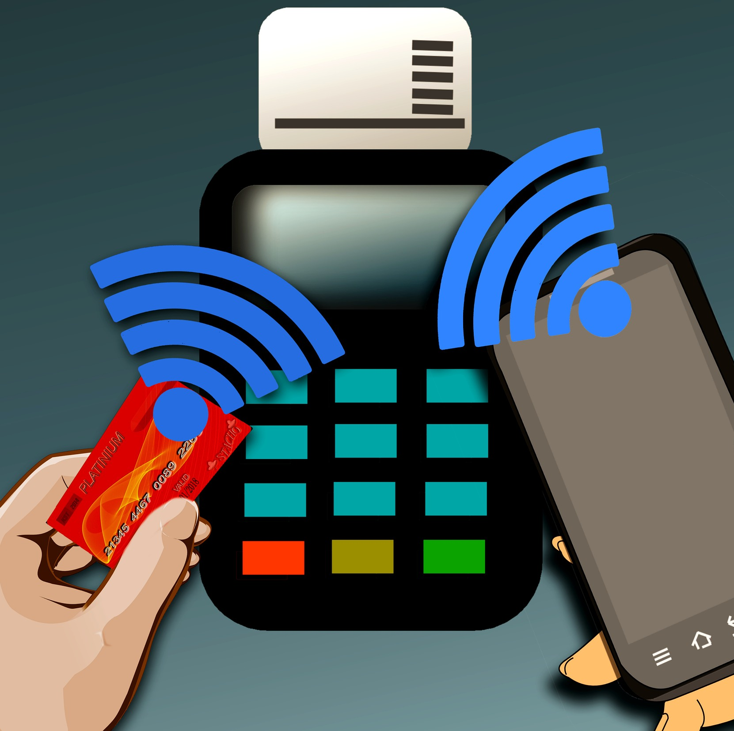
Tap-to-pay

Slide 2
Summary
What is it ?
How does it work ?
Defaults ?
Advantages ?
RFID-blocking wallet ?

Slide 3
What is it ?

Slide 4
How does it work ?
Radio-frequency identification
(RFID)
Near Field Communication
(NFC)

Slide 5
Defaults ?
Limits
Card reader
Internationally
Precautions
Deactivation

Slide 6
Advantages ?
Delay
PIN code
Applications
Covid-19
Security

Slide 7
Should we get an RFID-blocking wallet ?

Slide 8
Conclusion

